Slide 1






Agricultural Raw Material Analysis
Student Details
Name: Selvalakshmi M
NM Id: 2021507040
College Name: Madras Institute of Technology

Slide 2


Course Outline
Abstract
Problem Statement
Aims, Objective & Proposed System/Solution
System Deployment Approach
Model Development & Algorithm
Future Scope
Video of the Project
Conclusion
Reference

Slide 3
Abstract
In the agriculture sector, where countless decisions must be made daily amidst complex factors, accurate yield estimation is crucial for effective planning. Data mining techniques offer a practical and efficient means to address this challenge. Agriculture, being a prime candidate for big data applications, benefits from the analysis of various factors such as environmental conditions, soil variability, input levels, and commodity prices.
This paper aims to leverage data mining techniques, including PAM, CLARA, DBSCAN, and Multiple Linear Regression, to analyze agricultural data and identify optimal parameters for maximizing crop production. By mining extensive datasets encompassing crop, soil, and climatic information, as well as analyzing new, non-experimental data, the agricultural sector can enhance production and bolster resilience against climate change.
PAM (Partitioning Around Medoids), CLARA (Clustering Large Applications), and DBSCAN (Density-Based Spatial Clustering of Applications with Noise) are clustering algorithms that can identify patterns and groupings within agricultural data, aiding in understanding factors influencing crop yields. Multiple Linear Regression, on the other hand, provides a statistical method to model the relationship between various input variables and crop production, enabling predictive analysis and optimization.
By harnessing these data mining techniques, farmers and agribusinesses can make informed decisions, optimize resource allocation, and adapt to changing environmental conditions, ultimately enhancing productivity and sustainability in agriculture.

Slide 4
Problem Statement
In the field of agricultural economics, the volatility of raw material prices presents a significant obstacle for stakeholders, complicating decision-making and resource management. Historical data alone often fails to provide reliable forecasts, intensifying market uncertainty and risk. To address this challenge, there's a critical demand for robust predictive models that harness machine learning algorithms to scrutinize historical price trends and forecast future values accurately. Developing such models would equip stakeholders with invaluable insights to navigate market fluctuations, fine-tune pricing strategies, and promote sustainability within the agricultural sector.

Slide 5

Aim and Objective
The aim of this project is to conduct an in-depth analysis of agricultural raw material prices dataset through Exploratory Data Analysis (EDA). By examining historical price trends and fluctuations, the project seeks to identify high and low-range raw materials, assess percentage changes in prices to understand market volatility, and explore correlations between different types of raw materials. Ultimately, this analysis aims to provide valuable insights for stakeholders in the agricultural sector to make informed decisions regarding pricing strategies, supply chain management, and risk mitigation.

Slide 6
Objectives
The objective of the problem is to develop robust predictive modeling approaches that leverage machine learning algorithms to accurately forecast future prices of agricultural raw materials.
The fluctuating prices of raw materials pose a significant challenge for stakeholders in agricultural economics, hindering effective decision-making and resource allocation. The lack of accurate predictive models exacerbates this challenge, leading to increased market uncertainty and risk.
By addressing this need for accurate predictive modeling, stakeholders can gain actionable insights to navigate market dynamics, optimize pricing strategies, and enhance sustainability in the agricultural sector. Ultimately, the objective is to empower stakeholders with the tools and knowledge to make informed decisions and mitigate risks associated with price volatility in agricultural raw materials.

Slide 7
Proposed Solution
1. Data Preprocessing: Cleanse and preprocess the agricultural raw material prices dataset to handle missing values, outliers, and inconsistencies, ensuring the quality and integrity of the data for analysis.
2. Exploratory Data Analysis (EDA): Conduct comprehensive EDA to examine various aspects of the dataset, including descriptive statistics, distribution of prices, seasonal trends, and correlation between raw materials, providing a holistic understanding of the data.
3. Statistical Analysis: Utilize statistical techniques such as percentage change calculation, price range determination, and correlation analysis to quantify and interpret the patterns and relationships within the dataset, facilitating informed decision-making.
4. Visualization and Reporting: Present the analysis findings through clear and informative visualizations such as plots, charts, and heatmaps, accompanied by detailed reports summarizing key insights and recommendations for stakeholders in the agricultural sector.
Notes:
7

Slide 8
System Deployment Approach
Exploratory Data Analysis (EDA)
Data Collection
Data Preprocessing
Data Collection
Data Collection
Data Collection
Notes:
8

Slide 9
Model Development & Algorithm
:
The dataset contains agricultural raw material price data
Spanning three years from 2015 to 2021
Variables include Year, Material, and Price
Materials include Wheat, Corn, Soybeans,
Each material has price data recorded for all years
Notes:
9

Slide 10
Model Development & Algorithm
Utilized historical price data of agricultural raw materials to develop predictive models for forecasting future prices.
Choose suitable algorithms such as time series forecasting models (e.g., ARIMA, SARIMA, Prophet) or regression models (e.g., Linear Regression, Random Forest Regression, Gradient Boosting Regression).
Leverage insights from exploratory data analysis (EDA) to inform feature selection and model training processes, ensuring alignment with observed patterns and trends.
Evaluated the model performance using established metrics like Mean Absolute Error (MAE), Mean Squared Error (MSE), or Root Mean Squared Error (RMSE), alongside cross-validation techniques to validate predictive accuracy.
Visualized model predictions alongside actual price data, facilitating interpretation and communication of forecasted trends to stakeholders, enabling informed decision-making in agricultural markets.
Notes:
10

Slide 11
Result
Identified top 10 materials with the highest and lowest prices, providing insights into market valuation and potential investment opportunities or risks.
Calculated percentage changes in prices for each material, highlighting materials with significant price fluctuations over time, guiding strategic decision-making for stakeholders.
Analyzed price changes over the years, revealing trends and variations in prices across different materials, aiding in understanding market dynamics and planning future strategies.
Investigated correlations between numerical variables, revealing potential relationships and dependencies between agricultural materials, facilitating risk management and portfolio diversification strategies.
Leveraged insights from exploratory data analysis to develop predictive models for forecasting future prices, enabling stakeholders to anticipate market trends and make informed decisions in the agricultural sector.
Notes:
11

Slide 12
Future Scope
Looking ahead, integrating PowerBI into this project could revolutionize predictive analytics based on historical data. By leveraging PowerBI's capabilities, the bank can anticipate customer needs, offer proactive solutions, and enhance customer satisfaction and loyalty. Additionally, PowerBI's ability to consolidate diverse data sources opens avenues for incorporating additional datasets, providing a more comprehensive understanding of customer behaviors and preferences.
To address concerns around data privacy and security, future iterations of the project should prioritize robust data governance strategies. This involves securely handling sensitive customer data and adhering to stringent data protection regulations.
Exploring the integration of real-time data streams holds immense potential for delivering more timely insights. This approach could reshape customer interactions, driving enhanced experiences and fostering stronger relationships.
In essence, the future of this project lies in harnessing cutting-edge technologies, maintaining stringent data governance, and adapting to evolving customer needs and market dynamics. Through continuous innovation, the project can position the bank as a leader in customer-centric banking services.
Notes:
12

Slide 13
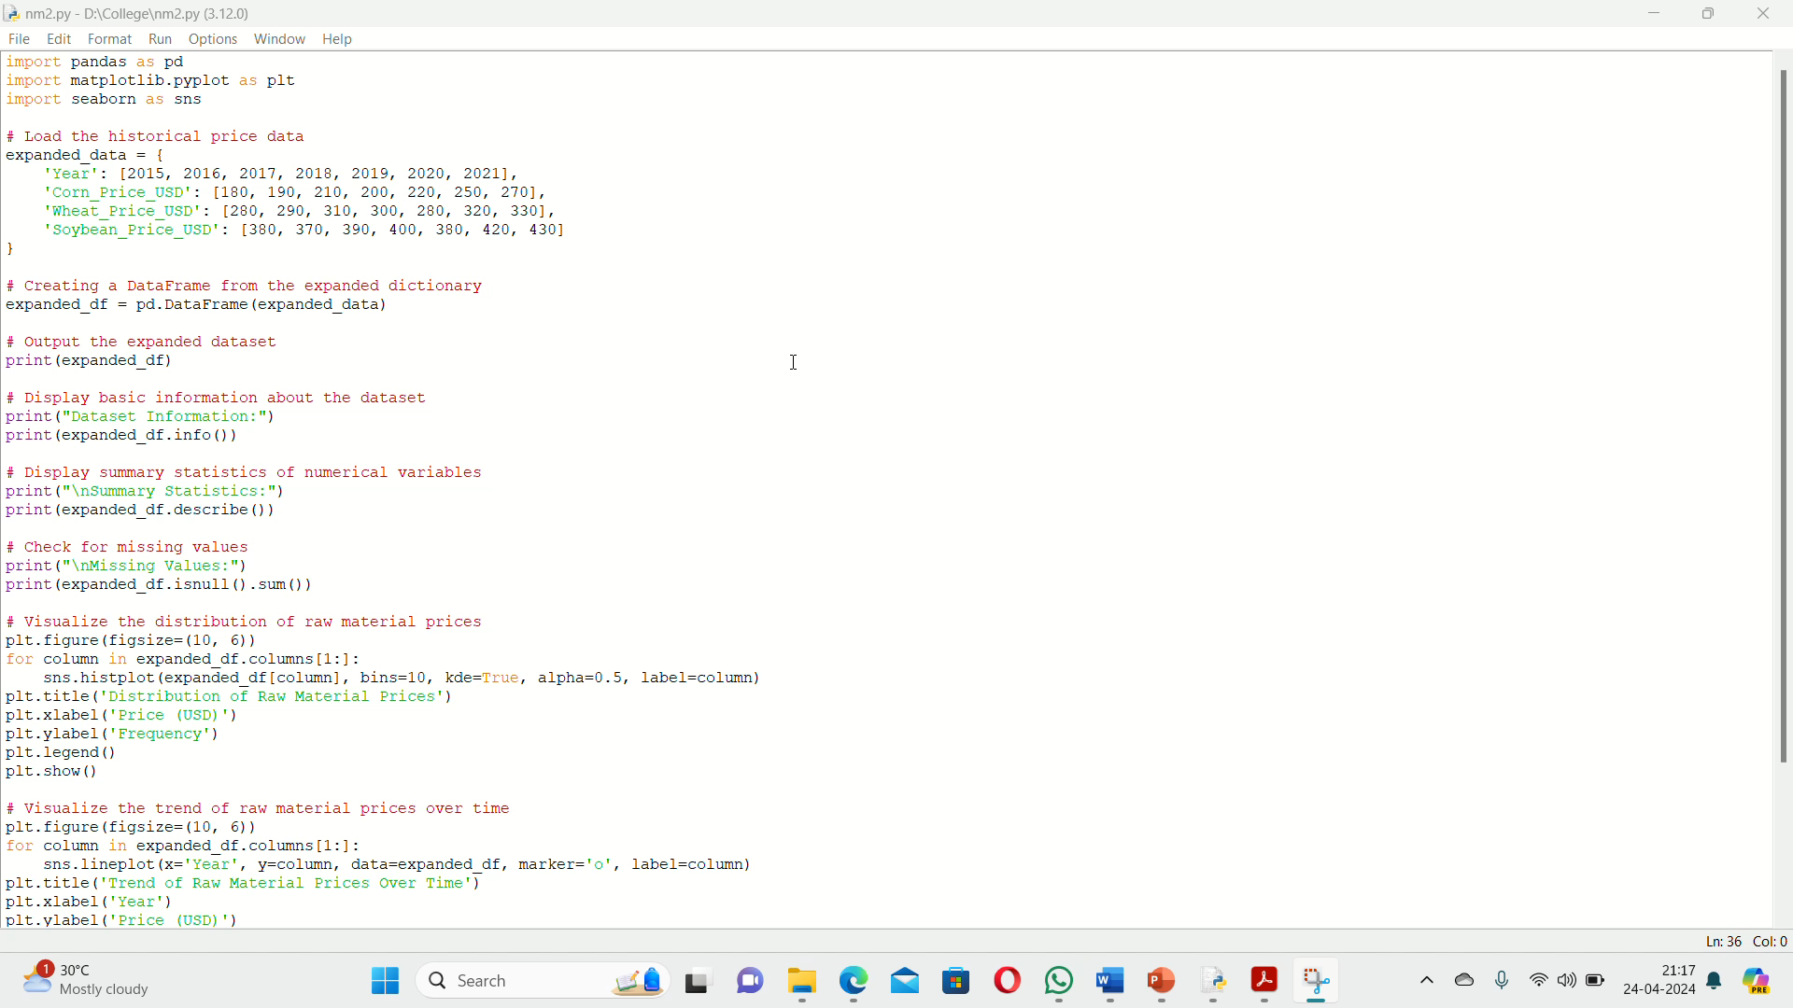
Video of the Project
Notes:
13

Slide 14
Conclusion
In conclusion, the developed code for predictive modeling of agricultural raw material prices offers a powerful framework for analyzing historical data, building predictive models, and gaining valuable insights into market dynamics. By leveraging machine learning algorithms and data analysis techniques, stakeholders in the agricultural sector can make informed decisions regarding resource allocation, pricing strategies, and risk management. The comprehensive approach to data analysis, model selection, and evaluation ensures accuracy and reliability in predicting raw material prices, ultimately enhancing decision-making processes and driving innovation in agricultural economics. This code serves as a valuable tool for stakeholders seeking to optimize operations, mitigate risks, and capitalize on market opportunities in the ever-evolving landscape of agricultural commodities.
Notes:
14

Slide 15
Reference
https://pandas.pydata.org/docs/
https://seaborn.pydata.org/tutorial.html
https://seaborn.pydata.org/examples/index.html
https://pandas.pydata.org/docs/
https://machinelearningmastery.com/time-series-forecasting/
https://en.wikipedia.org/wiki/Correlation
Notes:
Reference
These are the references for this session.

Slide 16
Thank you
Notes:
16

